Slide 2
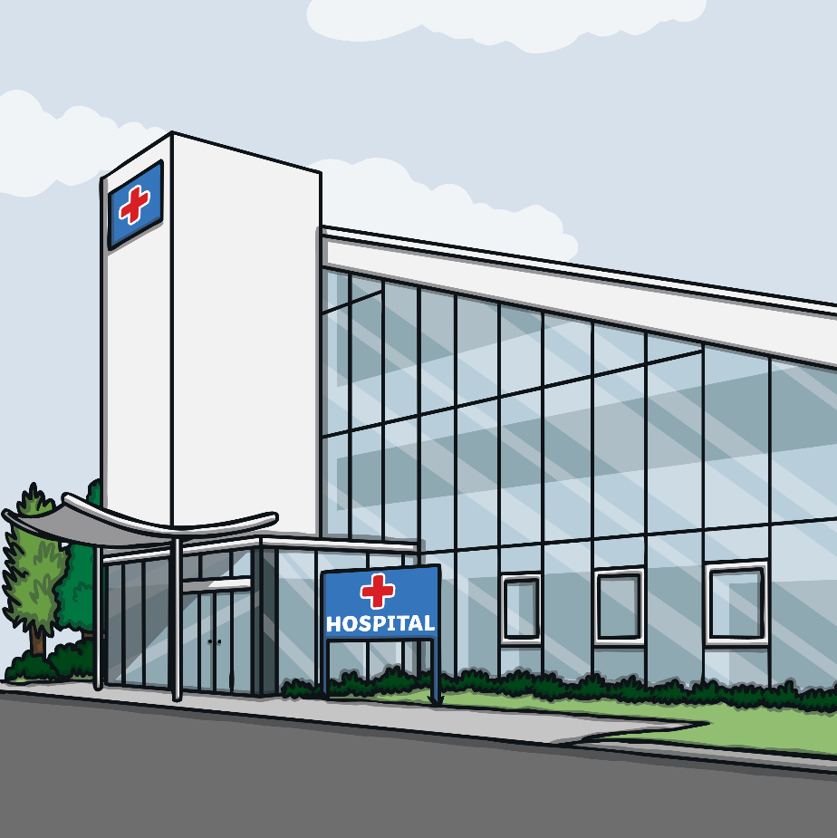
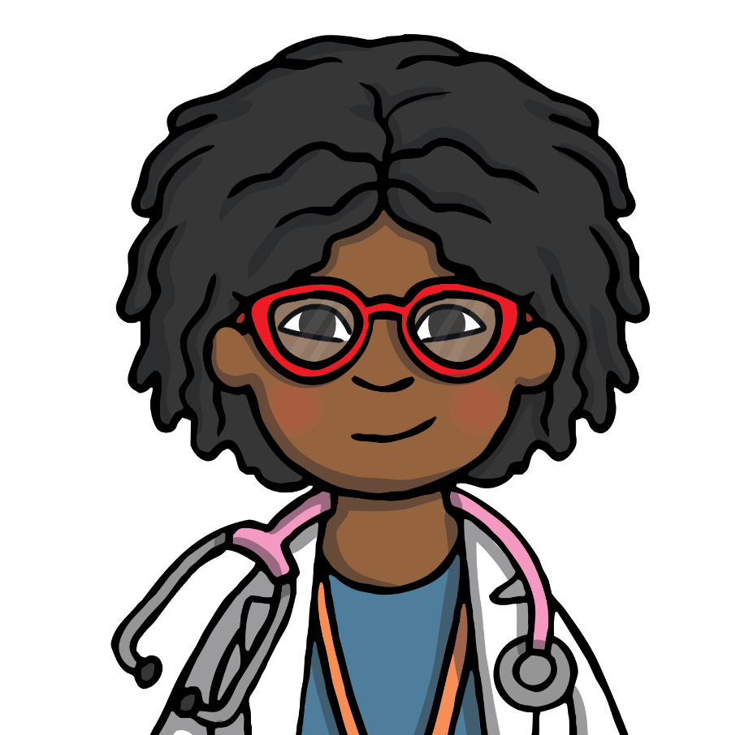
Meet Dr Elliot
Hello, I am Dr Elliot. A doctor is someone who makes people better.

Slide 3
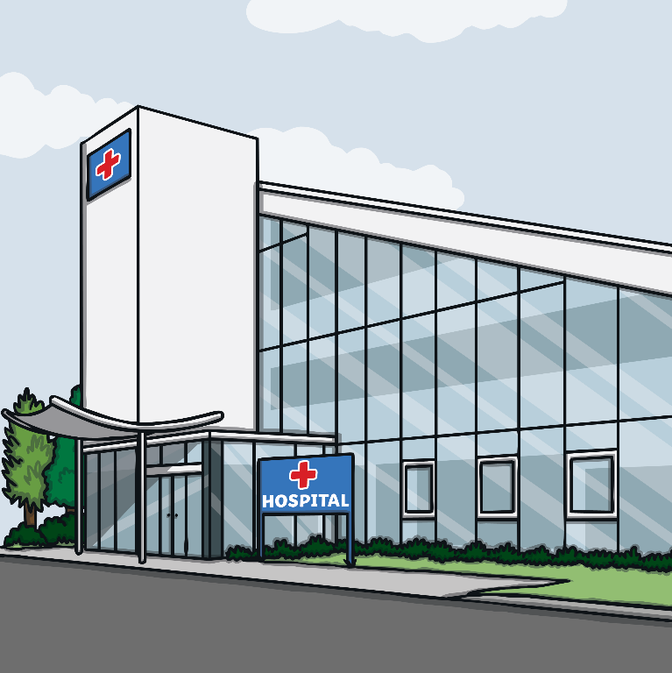
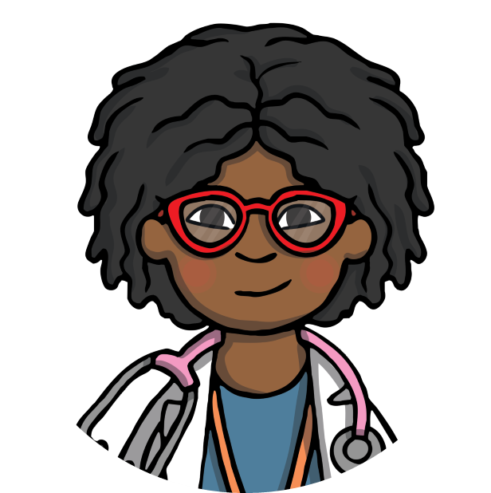
Hospitals
I work in a hospital. A hospital is a place where sick people go to get better. Sometimes they have operations or are given special medicine to help them feel better.
Have you ever visited someone in hospital?
Have you ever been in hospital yourself?
Talk about it

Slide 4
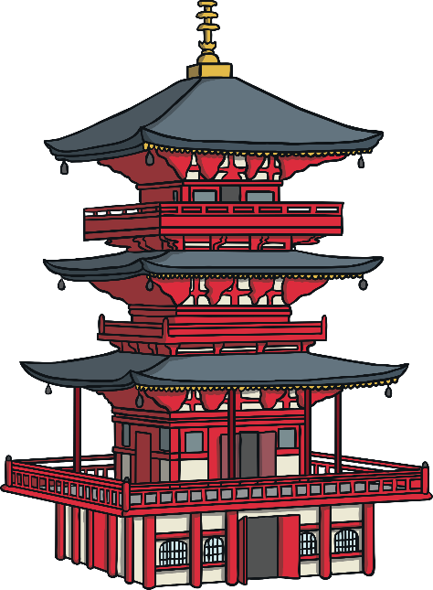
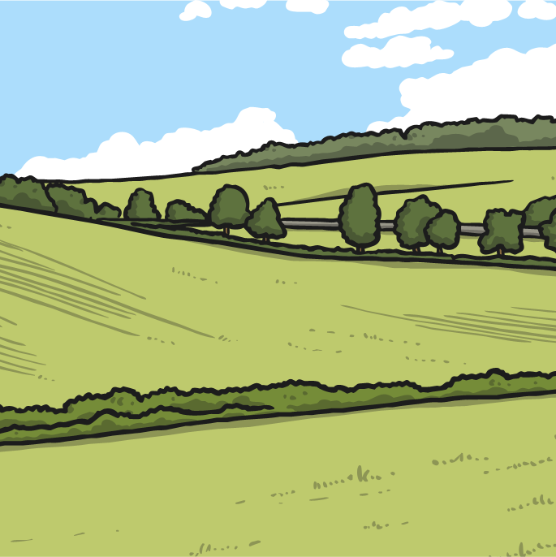
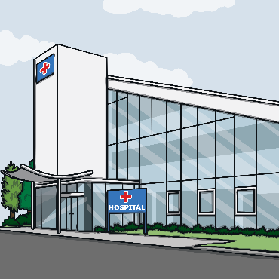
Early Hospitals
A very long time ago, there weren’t hospitals like the ones we know now. People went to special places like temples where they worshipped their gods when they were sick.
Let’s look at hospitals from the past and hospitals today. We will look at how they are similar and how they are different.

Slide 5
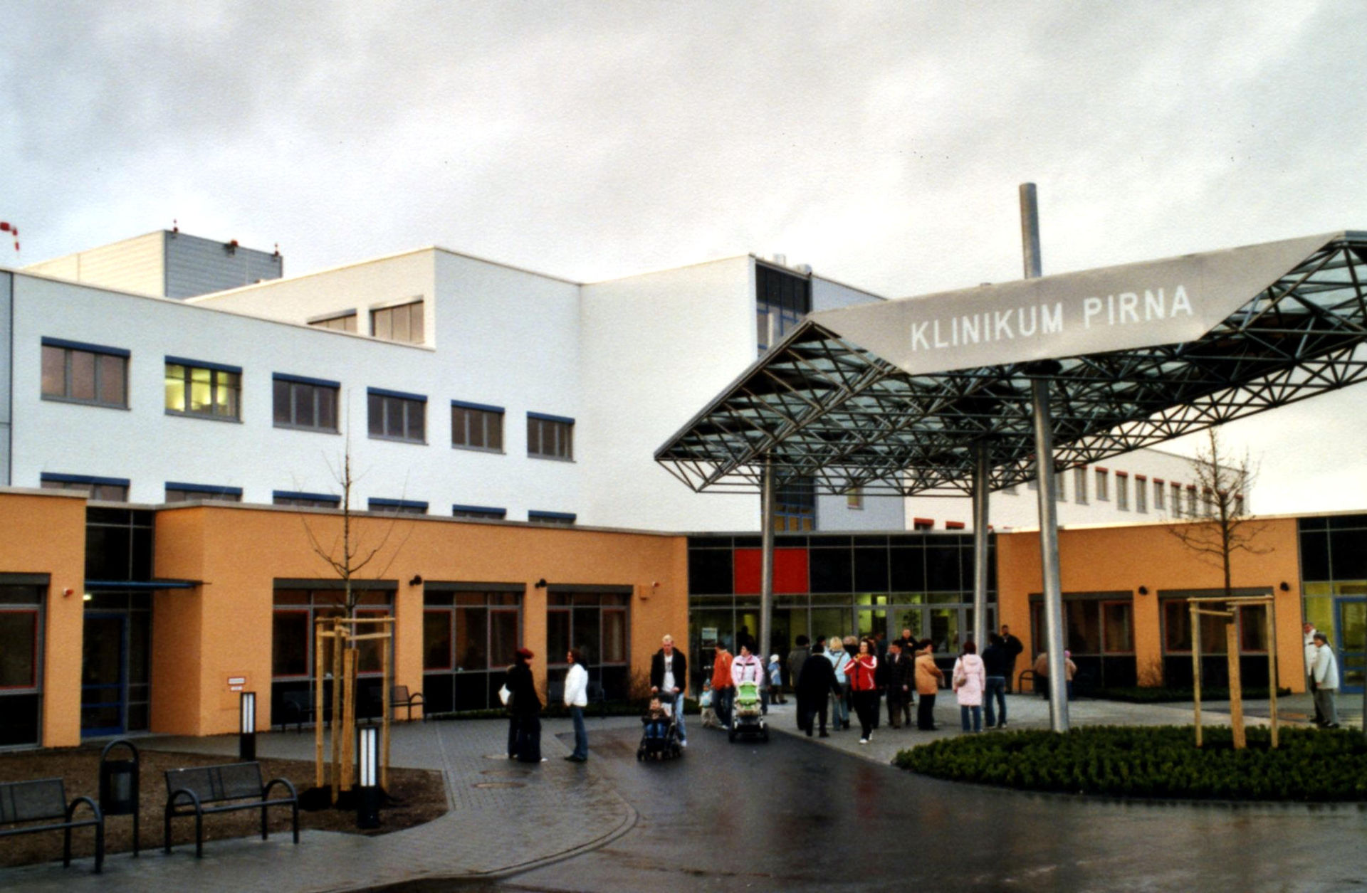
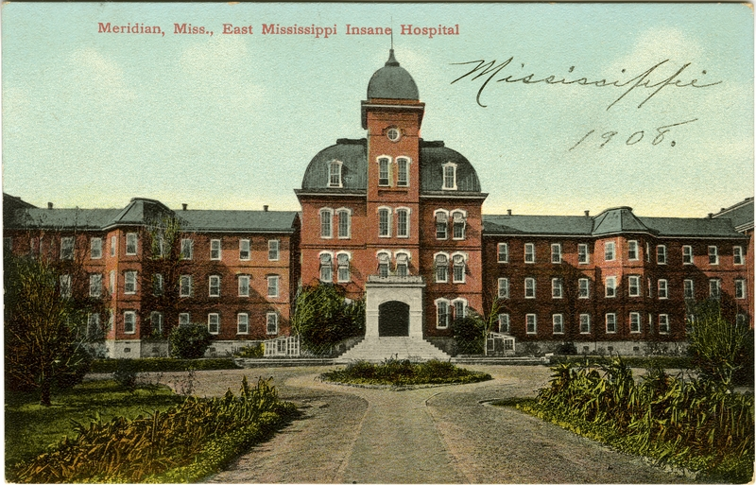
The Outside of a Hospital
Then
Now
East Mississippi State Hospital by Dudemanfellabra is licenced under 2.0 Hospital In Pena by Norbert Kaiser is licenced under 2.0

Slide 6
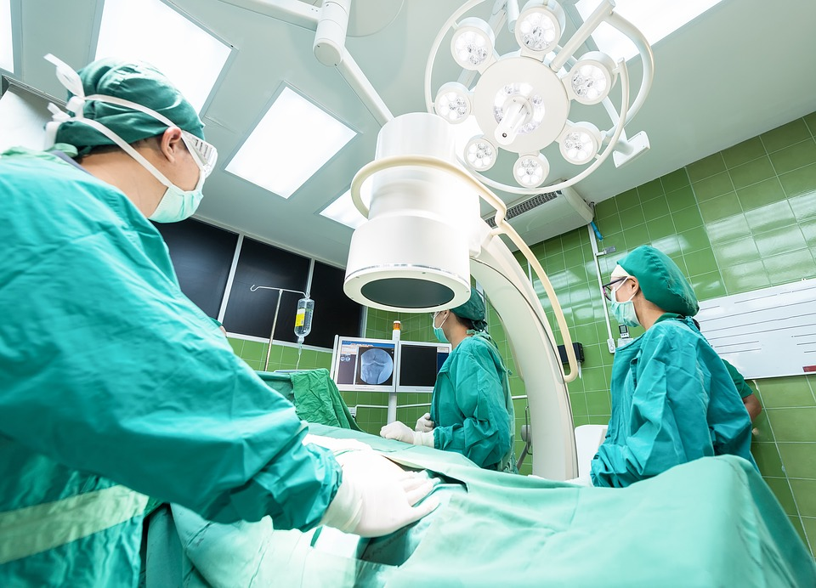
Theatres - Now
Theatres aren’t just places where actors perform plays! A theatre is also the name we call the room where operations are done.
Doctors often use tiny cameras and look on a screen to see inside people’s bodies!
Doctors and nurses wear masks and gloves to prevent germs from spreading.
Bright lights so doctors and nurses can see what they’re doing.

Slide 7
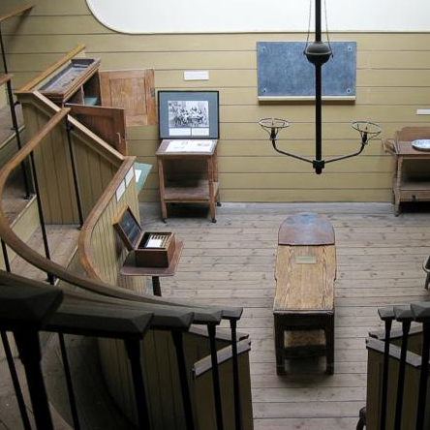
Theatres - Then
Doctors didn’t wear gloves or masks.
These are the seats where people used to watch operations being done.
Candles instead of electric lights.

Slide 8
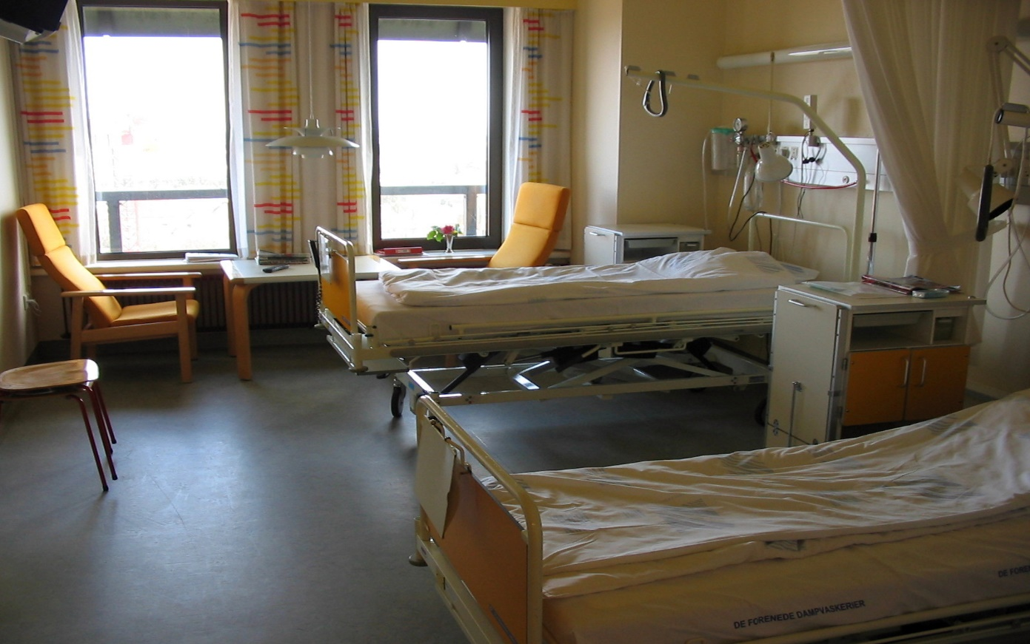
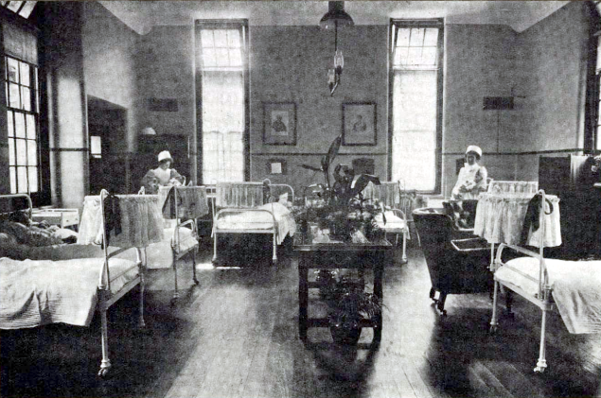
Wards
Now
Then
Hospital Ward by Dudemanfellabra is licenced under 2.0 Old Fashioned Hospital Ward by Norbert Kaiser is licenced under 2.0

Slide 9
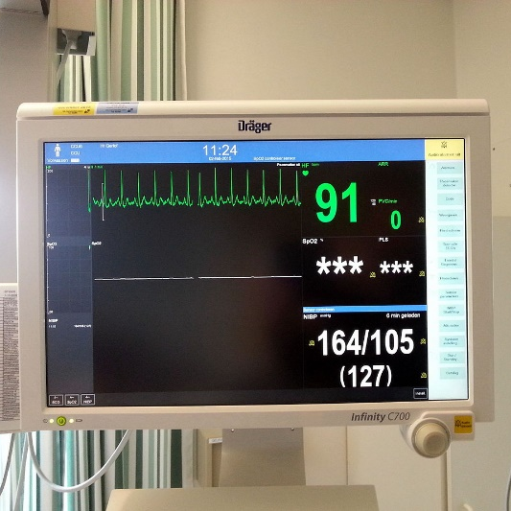
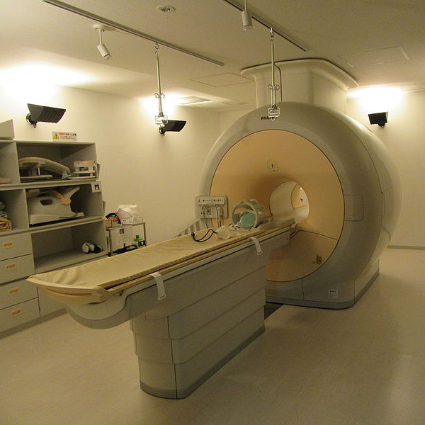
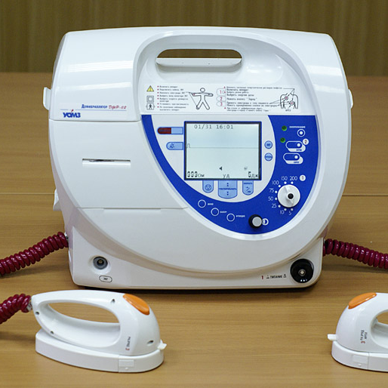
Special Equipment
Today, hospitals are full of special equipment that help doctors make people better.
This is a machine that measures people’s heartbeats.
This is called an MRI scanner. It takes photos of the inside of people’s bodies.
This is a machine that can help someone’s heart if it has stopped working properly.
Heart Monitor by Dudemanfellabra is licenced under 2.0, MRI Scanner by Norbert Kaiser is licenced under 2.0, Defibrillator by Malcom Kaiser is licenced under 2.0

Slide 10
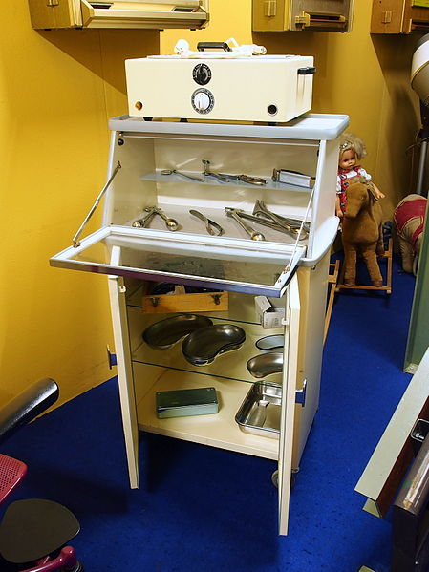
Special Equipment
A long time ago, hospitals didn’t have special equipment. They didn’t have lots of machines. Here is some equipment doctors used a long time ago. What do you think each item was used for?
Old Medical Equipment by Alfvanbeem is licenced under 2.0

Slide 11
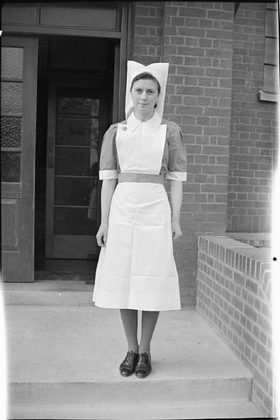
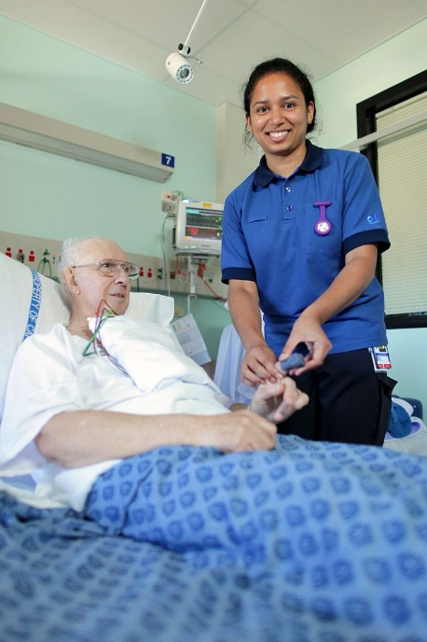
The Outside of a Hospital
Just like most school children, nurses in hospitals wear uniforms.
Look at these nurses. How are their uniforms different?
Then
Now
Life at St Hillier Hospital by Student Nurse a is licenced under 2.0 Canberra Hospital Ward by Norbert Wise is licenced under 2.0

Slide 12
Talk About It
Talk about all the changes you noticed in hospitals from now and then.

